Slide 1
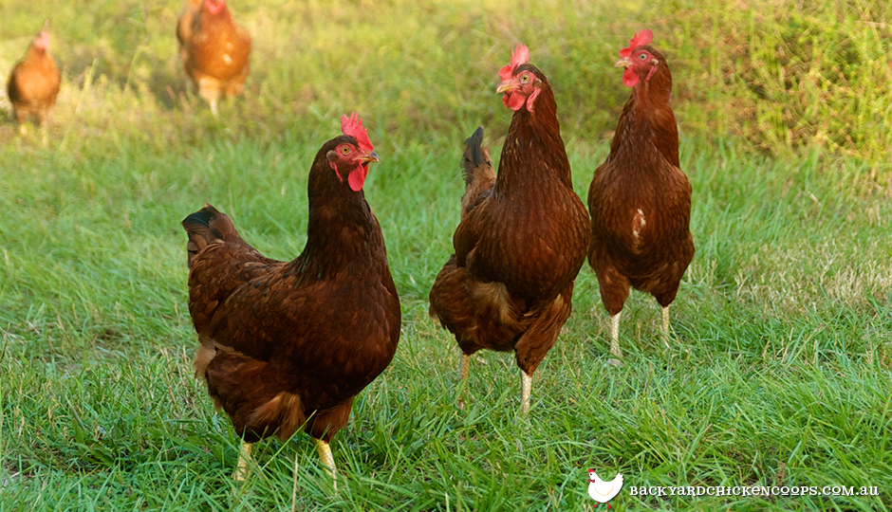
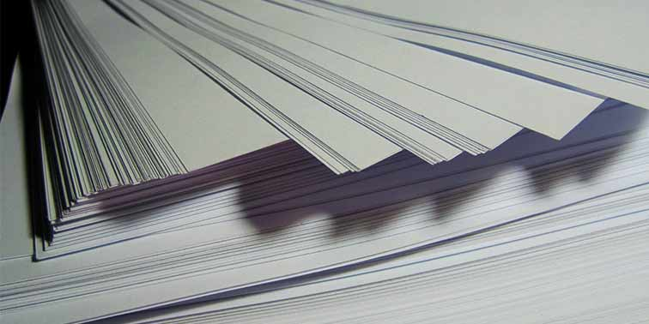

Daily review
Reminder
Move to find the resources they need Respond to changes in their environment Grow as they get older Reproduce to make new individuals Excrete waste products from their bodies Exchange gases with their environment Nutrition from food and water
All living things have 7 characteristics in common.
These can be remembered using the acronym
MR GREEN.
State whether each object is living, non-living or dead? Explain your choice using the MR GREEN characteristics.

Slide 2
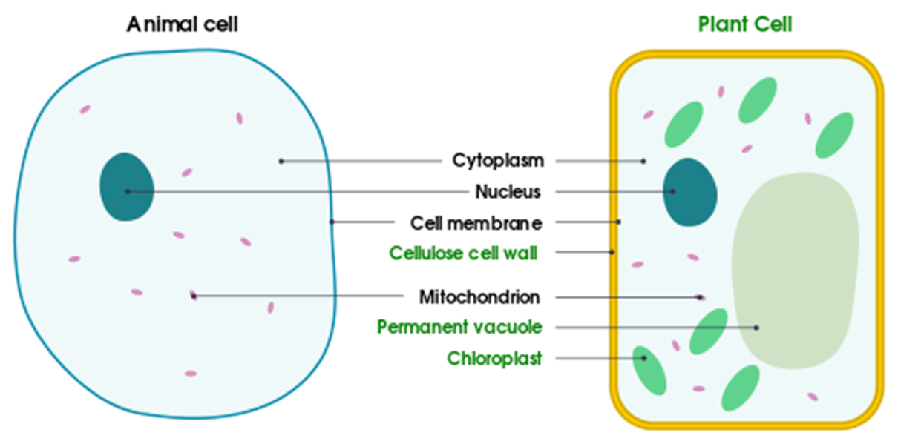
Daily review
Types of Cells
Cells are made of organelles
Some organelles are common to all cell types
Some organelles are unique to some cell types

Slide 3
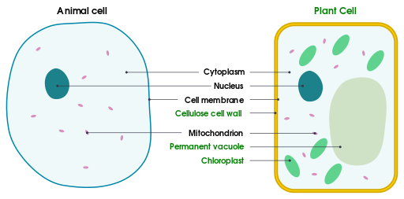
Daily review
Types of Cells
Divide your whiteboard in half
Write similarities on one side and differences on the other
For the animal and plant cells, list the similar organelles and the different organelles

Slide 4
Daily review
Types of Cells
The cell at the top is a fungal cell.
Which type of cell (animal or plant) is the fungal cell most similar to? Explain your choice.

Slide 5
From Cells to Body Systems

Slide 6
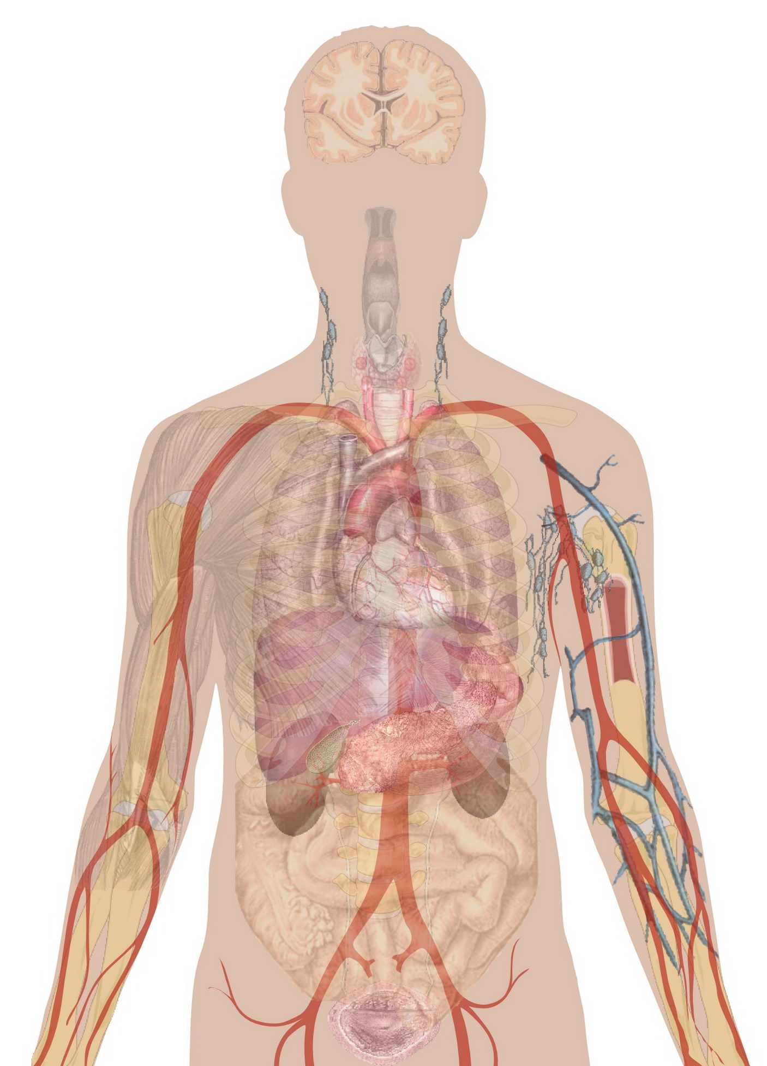
Learning Objectives
CFU
What are we going to learn?
Differentiate between cells, tissues, organs and systems.
Identify organs in the body and the system they belong in.
Activate Prior Knowledge
The human body contains many organs, each with a particular function.
On your whiteboard, name three organs and their function in the body.

Slide 7
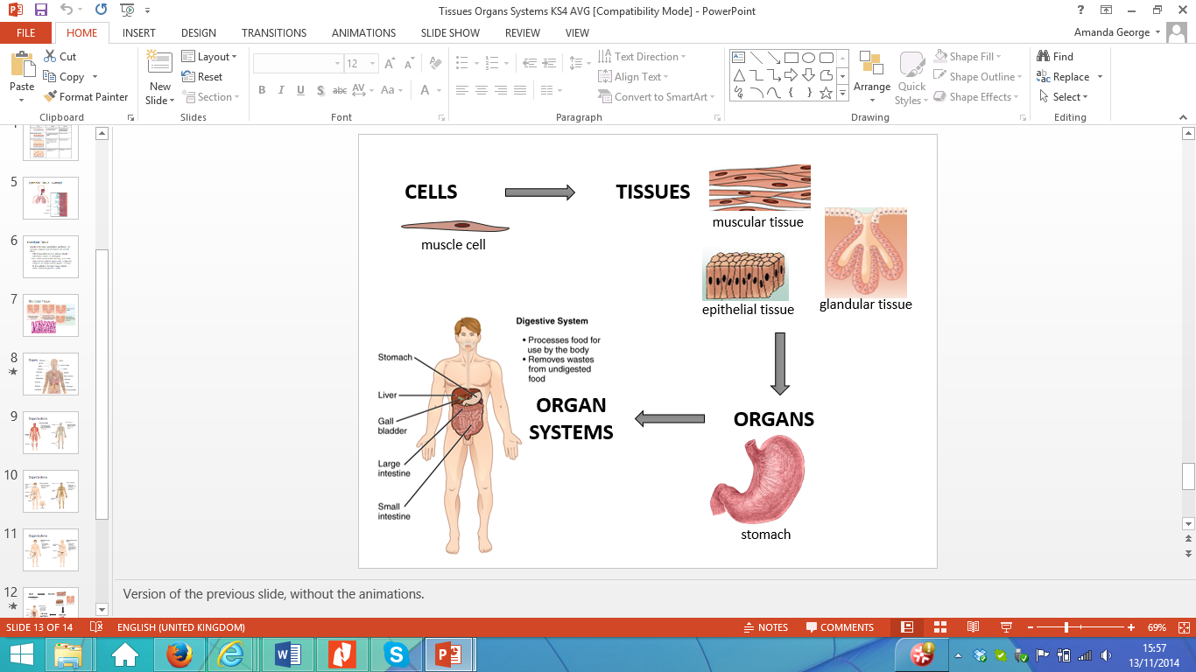
Concept Development
CFU 1
In an organism, what are tissues?
Cells → Tissues → Organs → Systems
Cells are the basic building blocks of life
Tissues are groups of cells with the same function
Organs are groups of tissues that work together
Systems are multiple organs working together to perform one or more of the 7 characteristics of living things
CFU 2
When groups of tissues work together, what are they called?
CFU 3
What is a system and what is its function?

Slide 8
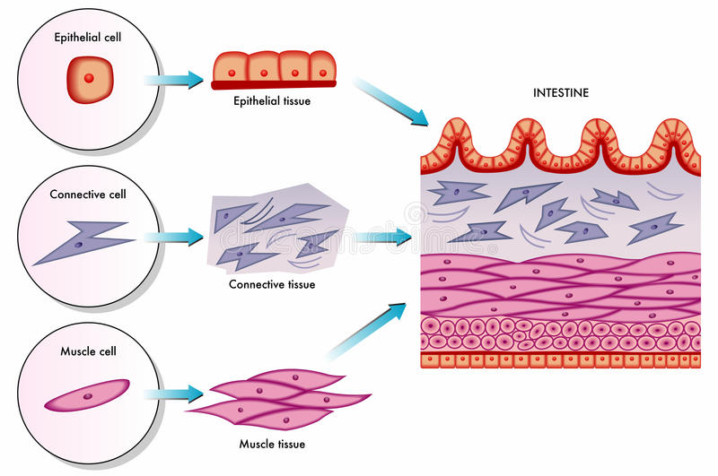
Concept Development
CFU 1
How is a tissue different to a cell?
Cells → Tissues → Organs → Systems
CFU 2
How many types of tissue are in the intestine?
CFU 3
What type of cells makes up the muscle tissue?

Slide 9
Concept Development
Reminder
Move Respond Grow Reproduce Excrete waste Exchange gases Nutrition
CFU 1
Which of the 7 characteristics does the musculoskeletal system allow the human body to perform?
Organ Systems
Each organ system has one or more functions
One organ might belong to multiple systems
Digestive system – breaks down food for nutrients
Respiratory system – supplies the body with oxygen
Excretory system - removes waste from the body
Musculoskeletal system – gives the body structure and allows it to move.
Circulatory system – carries oxygen, nutrients and waste around the body
CFU 2
The stomach and intestines are part of which system?
CFU 3
Other than the excretory system, which other system is involved in excreting waste?

Slide 10
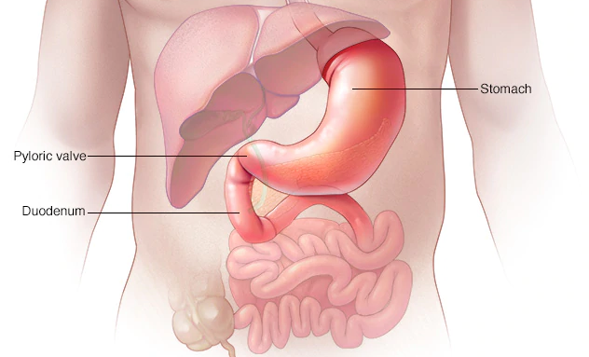
Skill Development/Guided Practice
CFU 1
What system does the organ belong to?
Describing the function of organs and systems
Step 1: Identify the system the organ belongs to
Step 2: State the function of the system
Step 3: Describe which characteristics of living things it allows the organism to perform
CFU 2
What is the function of the system?
CFU 2
Which characteristics does it allow the body to perform?
Describe the function of the stomach.
7 Characteristics
Move Respond Grow Reproduce Excrete waste Exchange gases Nutrition
The stomach is part of the digestive system. The digestive system helps the body break down food. This provides the body with nutrition and helps it grow.
Body Systems
Digestive Respiratory Excretory Circulatory Musculoskeletal

Slide 11
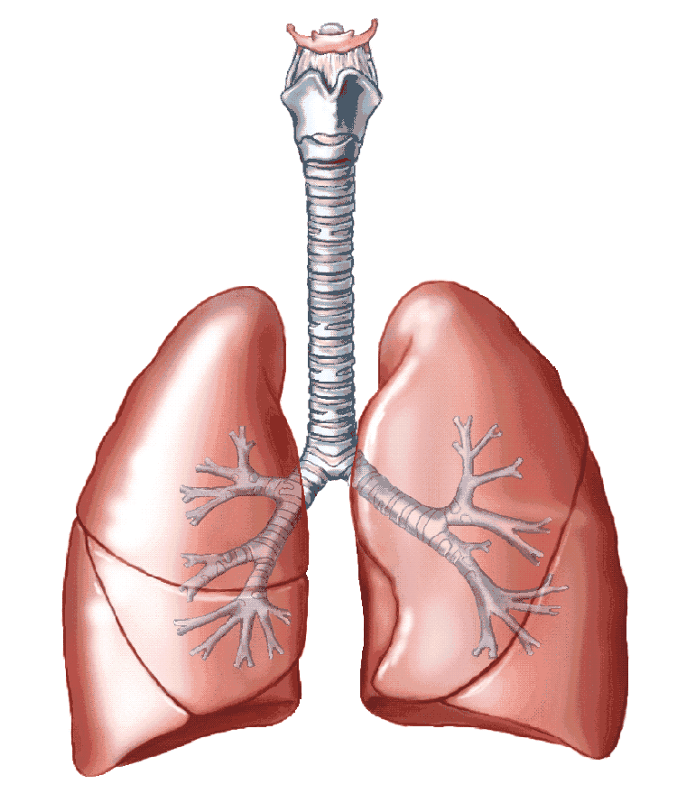
Skill Development/Guided Practice
CFU 1
What system does the organ belong to?
Describing the function of organs and systems
Step 1: Identify the system the organ belongs to
Step 2: State the function of the system
Step 3: Describe which characteristics of living things it allows the organism to perform
CFU 2
What is the function of the system?
CFU 2
Which characteristics does it allow the body to perform?
Describe the function of the lungs.
7 Characteristics
Move Respond Grow Reproduce Excrete waste Exchange gases Nutrition
The lungs are part of the respiratory system. The respiratory system supplies the body with oxygen. This lets the body exchange gases.
Body Systems
Digestive Respiratory Excretory Circulatory Musculoskeletal

Slide 12
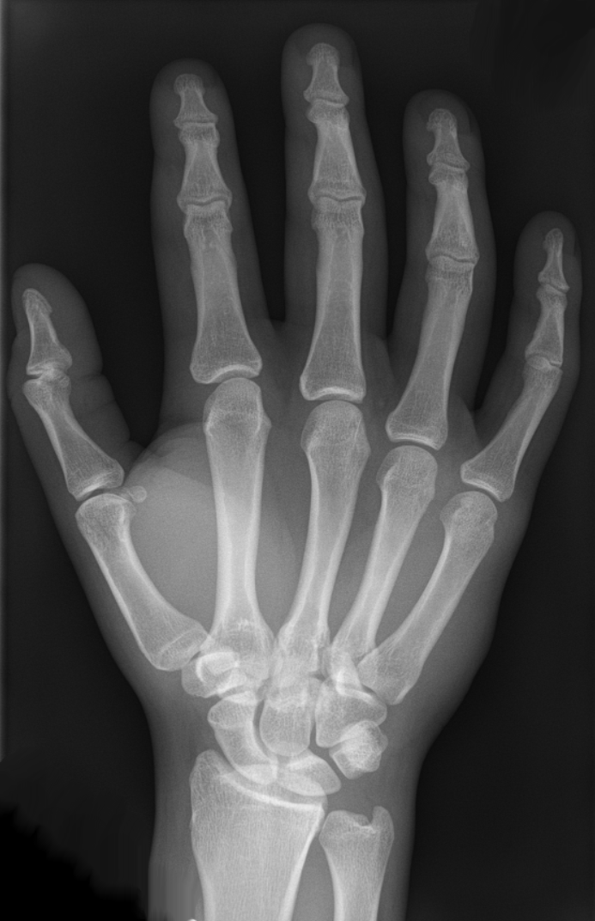
Skill Development/Guided Practice
CFU 1
What system does the organ belong to?
Describing the function of organs and systems
Step 1: Identify the system the organ belongs to
Step 2: State the function of the system
Step 3: Describe which characteristics of living things it allows the organism to perform
CFU 2
What is the function of the system?
CFU 2
Which characteristics does it allow the body to perform?
Describe the function of the bones.
7 Characteristics
Move Respond Grow Reproduce Excrete waste Exchange gases Nutrition
The bones are part of the musculoskeletal system. This system provides support for the body and allows the body to move.
Body Systems
Digestive Respiratory Excretory Circulatory Musculoskeletal

Slide 13
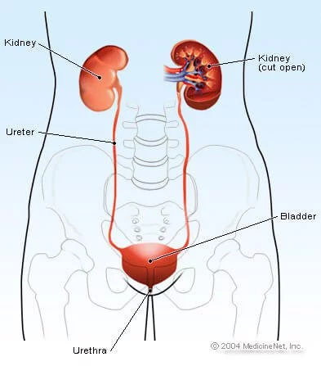
Skill Development/Guided Practice
CFU 1
What system does the organ belong to?
Describing the function of organs and systems
Step 1: Identify the system the organ belongs to
Step 2: State the function of the system
Step 3: Describe which characteristics of living things it allows the organism to perform
CFU 2
What is the function of the system?
CFU 2
Which characteristics does it allow the body to perform?
Describe the function of the bladder.
7 Characteristics
Move Respond Grow Reproduce Excrete waste Exchange gases Nutrition
The bladder is part of the excretory system. This allows the body to excrete waste products.
Body Systems
Digestive Respiratory Excretory Circulatory Muscular-skeletal

Slide 14
Relevance
Knowing the characteristics of living things will help you recognise the purpose of different organs.
Knowing how organs work together in a system and how the systems interact with each other will help you understand how the body works.

Slide 15
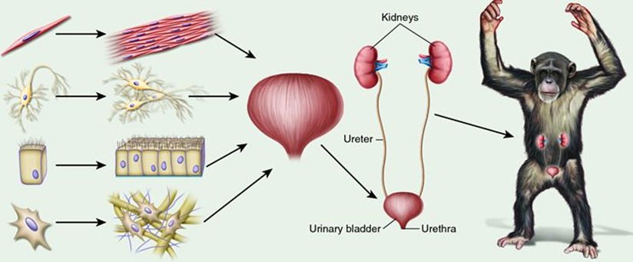
Skill Closure
Describe the difference between a tissue and a cell.
Skill Closure
In the flow chart, how many types of tissue are there in a bladder?
Skill Closure
One of the functions of the kidneys is to produce urine. Which body system are the kidneys part of? Explain your choice.
Body Systems
Digestive Respiratory Excretory Circulatory Musculoskeletal

Slide 16
Independent Practice
System | Organs in the system | Characteristics of living things this system links to
 | Mouth, stomach, intestines
 | Lungs, nose, trachea
 | Muscles, bones
 | Heart, veins, arteries
 | Kidneys, bladder, skin, lungs
 | Ovaries, penis, uterus, testes
 | Brain, eyes, ear, skin, nerves
Copy the table into your workbook or on your device.

Slide 17
Independent Practice
System | Organs in the system | Characteristics of living things this system links to
 | Mouth, stomach, intestines
 | Lungs, nose, trachea
 | Muscles, bones
 | Heart, veins, arteries
 | Kidneys, bladder, skin, lungs
 | Ovaries, penis, uterus, testes
 | Brain, eyes, ear, skin, nerves
Fill in the ‘system’ column with the system it belongs to.
Respiratory,
Musculoskeletal,
Digestive,
Reproductive,
Nervous,
Circulatory,
Excretory

Slide 18
Independent Practice
System | Organs in the system | Characteristics of living things this system links to
 | Mouth, stomach, intestines
 | Lungs, nose, trachea
 | Muscles, bones
 | Heart, veins, arteries
 | Kidneys, bladder, skin, lungs
 | Ovaries, penis, uterus, testes
 | Brain, eyes, ear, skin, nerves
Complete the last column by naming the characteristics of living things that it performs. (May be multiple)
Move,
Respond,
Grow,
Reproduce,
Excrete waste,
Exchange gases,
Nutrition

